Slide 1

LEVERAGING GIS TOOLS FOR IMPROVED LAND TENURE MANAGEMENT
BY
ODIANONSE OJIEMOHIN

Slide 2





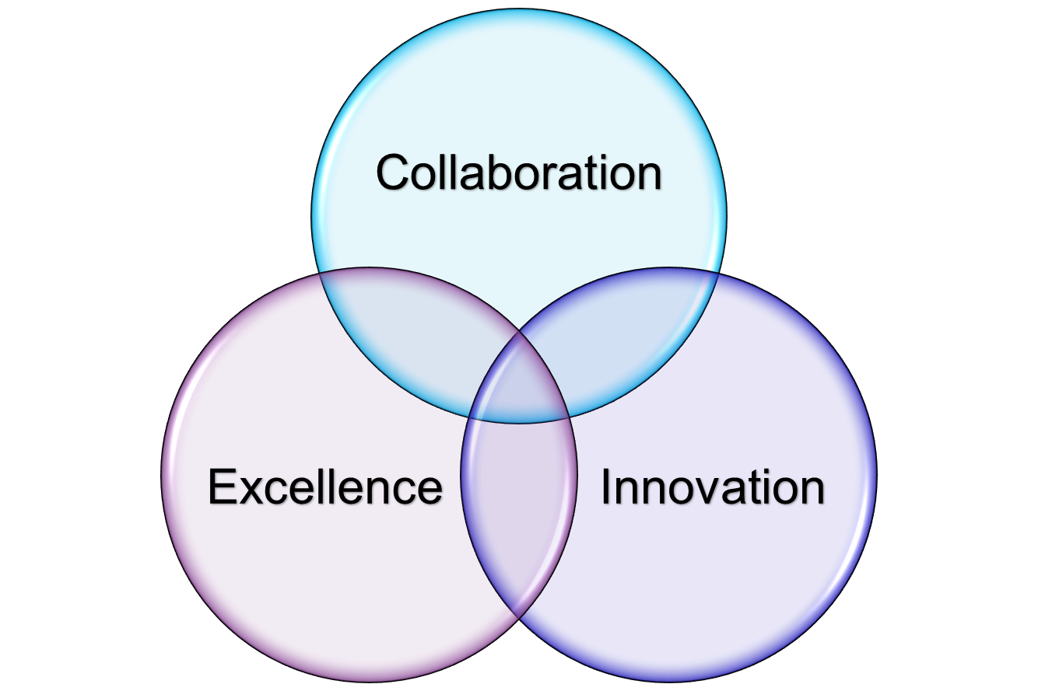



Jamitan Tech
13
Diverse
Years
Industries
Strategic
5 years in GIS and
Systems Integration
Statistics
Telecommunications
AEC
Real Estate
Land Administration
etc..
Partnerships
^{Certified}
Geospatial Experts
Esri Business Partner
Partner in Nigeria
CURRENT PROJECT
1. Nigerian Communication Commission (NCC)-
2. Federal Capital Territory Administration (FCTA)- Street Addressing System
3. National Population Commission (NPC)- Digital Census
40
NITDA
3
Cities
Certified
In Nigeria Region
Core values
Notes:
Jamitan Tech is a Nigerian geospatial company that provides Geographic Information System (GIS) services to various industries.
Spatial Data Infrastructure (SDI) refers to a framework of geographic data, metadata, users, and tools intended to provide an efficient way to use, manage, and share spatial information.
For the first time the next census Is going to be a digital one. All Enumerators will have a tab with a map of their area assigned to them. All data will be inputed on the tab and sent to a database.

Slide 3
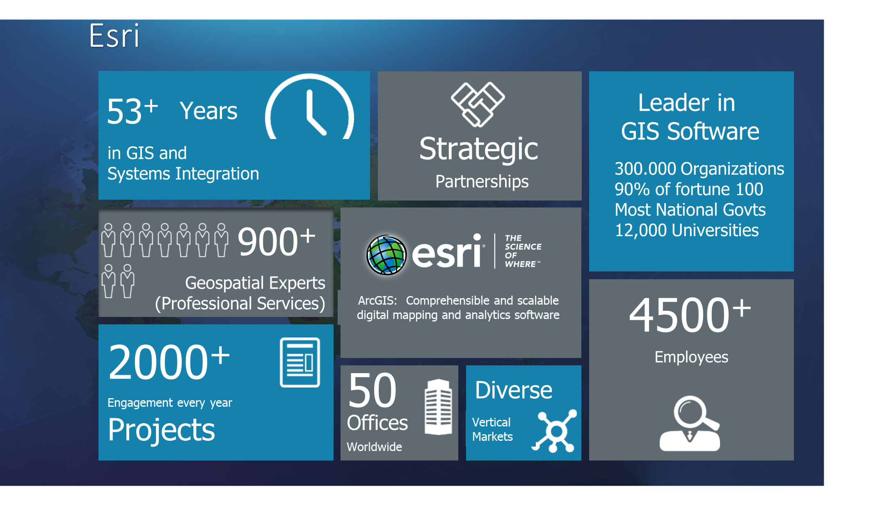

Slide 4
LAND TENURE SYSTEM
The Land Tenure System is the process of granting ownership of land to individuals, legal bodies, corporate bodies, and natural bodies based on their use of these lands.
For a land tenure system to be efficient you must have an Efficient LIS System.

Slide 5
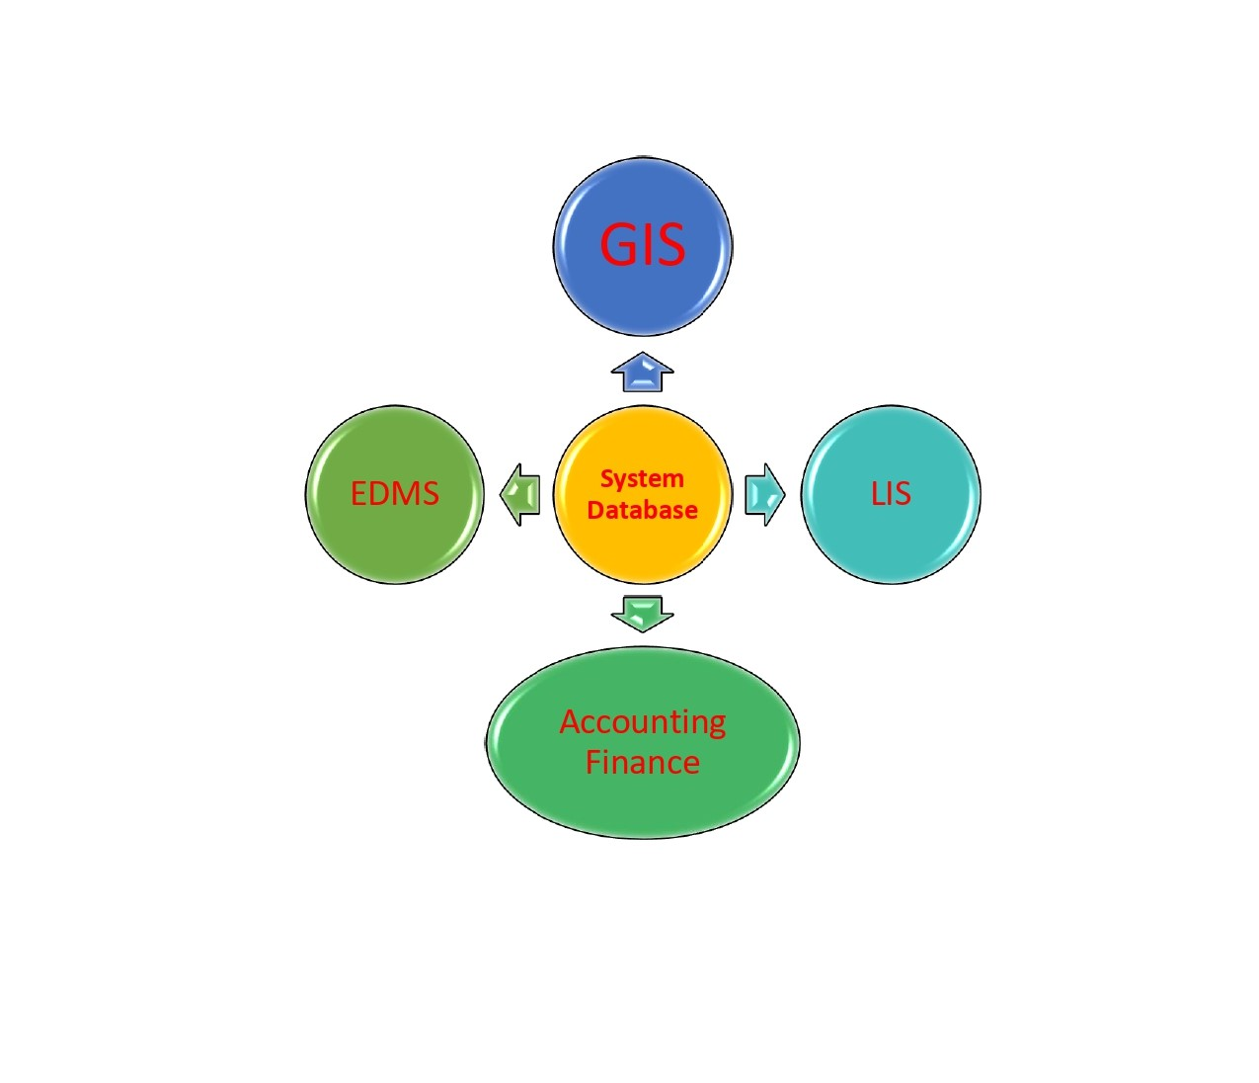
PILLARS OF AN LIS SYSTEM
Notes:
GIS- Geographic Information System
LIS- Land Information System
EDMS- Electronic Document Management System
Finance-
All these 4 sits on the a database.

Slide 6
FUNCTIONALITY
When setting up a Land Information System (LIS), functionality is a crucial aspect that determines the system's capabilities and effectiveness.
The functionality of an LIS refers to the range of features and tools that it offers to manage, analyze, and visualize land-related information.
Notes:
It must be effective and capable of handling the range of features which include manage, analyze, visualize land related informations.

Slide 7
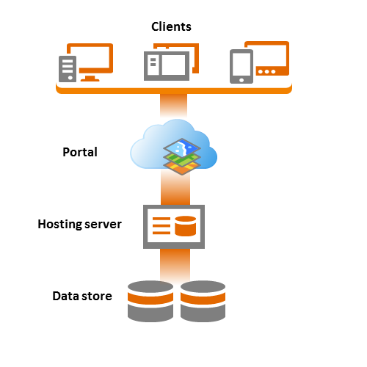
SCALABILITY
Refers to an application's ability to handle workload variation while adding or removing users with minimal costs.
Notes:
An LIS System must be scalable. At the initial stage if the transactions being carried out was 200, what happens to the system when it increases to 1000. A scalable system when the workload increases the system capability can increase with minimal cost and little little or no configuration, it remains stable. The ArcGIS Pro Enterprise is a very scalable system. It has 3 components which include – SERVER, PORTAL, DATA STORE. When the ArcGIS Pro needs to be scaled up, all you need to do is increase or expand the size of the server. It offers data protection unlike the open source systems.

Slide 8
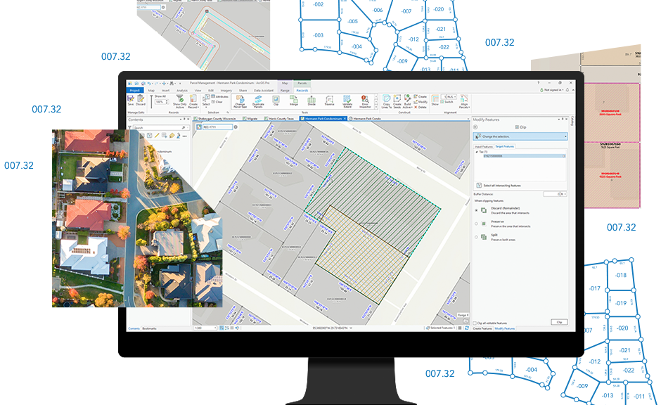
LAND PARCEL FABRIC
Land parcel fabric is like a digital quilt that helps organize and manage information about land parcels. It's a computer-based system that keeps track of different pieces of land, their boundaries, and related details in a structured and interconnected way.
A digital framework that brings together information about land parcels in a way that is easy to manage, analyze, and update.
Notes:
QUILT- two layers of cloth filled with padding (such as down or batting) held in place by ties or stitched designs. . Imagine each land parcel as a square on the quilt, and the fabric stitches together all these squares to create a comprehensive picture of land ownership and use. It's a valuable tool for effective land administration and decision-making.

Slide 9
DEMO

Slide 10
GIS data can be stored in different file formats, depending on the type of data and software used. Here are some of the most common GIS File formats:
SHAPEFILE (.SHP): This is one of the most commonly used file formats for GIS data. It stores the geometry of geographic features (points, lines, and polygons) as well as their attributes (such as names or population data).
EXCEL- The XLS file extension is used for files saved as Microsoft Excel worksheets. Excel is a popular spreadsheet program used with data like numbers and formulas, text, and drawing shapes
GEOJSON (.JSON): This is a format that is used for storing geographic data in JSON (JavaScript Object Notation) format. It is lightweight and easy to read, making it popular for web-based applications.
KEYHOLE MARKUP LANGUAGE (.KML): This is an XML-based format developed by Google for storing geographic data. It is commonly used for sharing geographic data with Google Earth.
GEOTIFF (.TIF): This is a format for storing georeferenced raster images (such as satellite imagery). It includes metadata such as coordinate system information.
Notes:
Some of you will say the ArcGIS Enterprise or online is expense. Very soon the ArcMAP will be retired by March 1, 2026. There are various ways you can pay for it. There are perpetual licenses. Even if you don’t renew you can still have your data intact and work with what you have. Its necessary we start getting accustomed to ArcGIS Pro.

Slide 11
POSTGRESQL/POSTGIS: This is an open-source relational database management system that includes extensions for working with geospatial data. It can store both vector and raster data and supports advanced spatial queries.
GEOPACKAGE (.GPKG): This is a open standard file format for GIS data. It supports both vector and raster data, and can store multiple layers in a single file. It is designed to be cross-platform and can be used with a variety of software packages.
GPKG (.GPKG): This is a geospatial data format based on SQLite that can store vector and raster data, including geometries, attributes, and metadata.
ESRI FILE GEODATABASE (.GDB): This is a proprietary format developed by Esri for storing GIS data in a database. It supports both vector and raster data and can be used with Esri's ArcGIS software.

Slide 12
NETCDF (.NC): This is a binary data format commonly used for storing multidimensional scientific data, including geospatial data such as climate and weather models.
CSV (.csv): This is a text-based format that stores tabular data, such as attribute data associated with GIS features.
These are just a few examples of the many GIS data formats that exist. The choice of format depends on the type of data, software used, and specific needs of the user.

